Slide 1
Knight’s Tour Problem
Presented to : Dr. Chaklam Silpasuwanchai
Team members : Lakshmi Narayana Naidu (st122893)
Vidath Singarapu (st122909)

Slide 2
Contents
Introduction
Approach to Knight’s Tour problem
Backtracking
Depth First and Breadth First Search
Improved DFS using Warnsdorff’s rule
Comparisons
Part that we are proud of
Limitations and Future Work

Slide 3
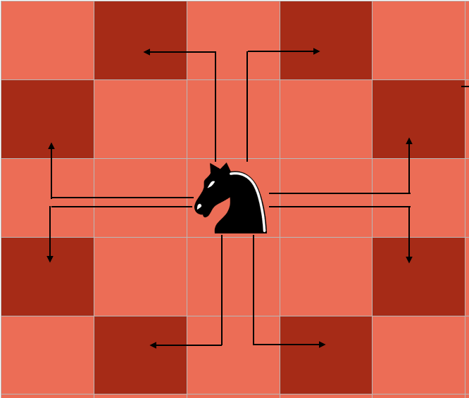
Introduction
This Knight’s tour problem defines that whether it is possible to travel all the possible squares of chess from the starting position of the chessboard.
For a person who is not familiar with chess, the knight moves two squares horizontally and one square vertically, or two squares vertically and one square horizontally
To be clear a Knight can move only in eight specific directions/blocks from its current location. Backtracking is basically recursion with undoing the recursive step if a solution for the given path does not exist.
So we wanted to explore the classical Knight’s Tour problem using the data structures and algorithms we learned in the class.

Slide 4
Approach to Knight’s Tour Problem
We start by moving the knight and if the knight reaches to a cell from where there is no further cell available to move and we have not reached to the solution yet (not all cells are covered), then we backtrack and change our decision and choose a different path.
So from a cell, we choose a move of the knight from all the moves available, and then recursively check if this will lead us to the solution or not. If not, then we choose a different path.
There can be two ways of finishing the knight’s Tour - the first in which the knight is one knight's move away from the cell from where it began, so it can go to the position from where it started and form a loop, this is called closed tour; the second is in which the knight finishes anywhere else, this is called open tour.

Slide 5
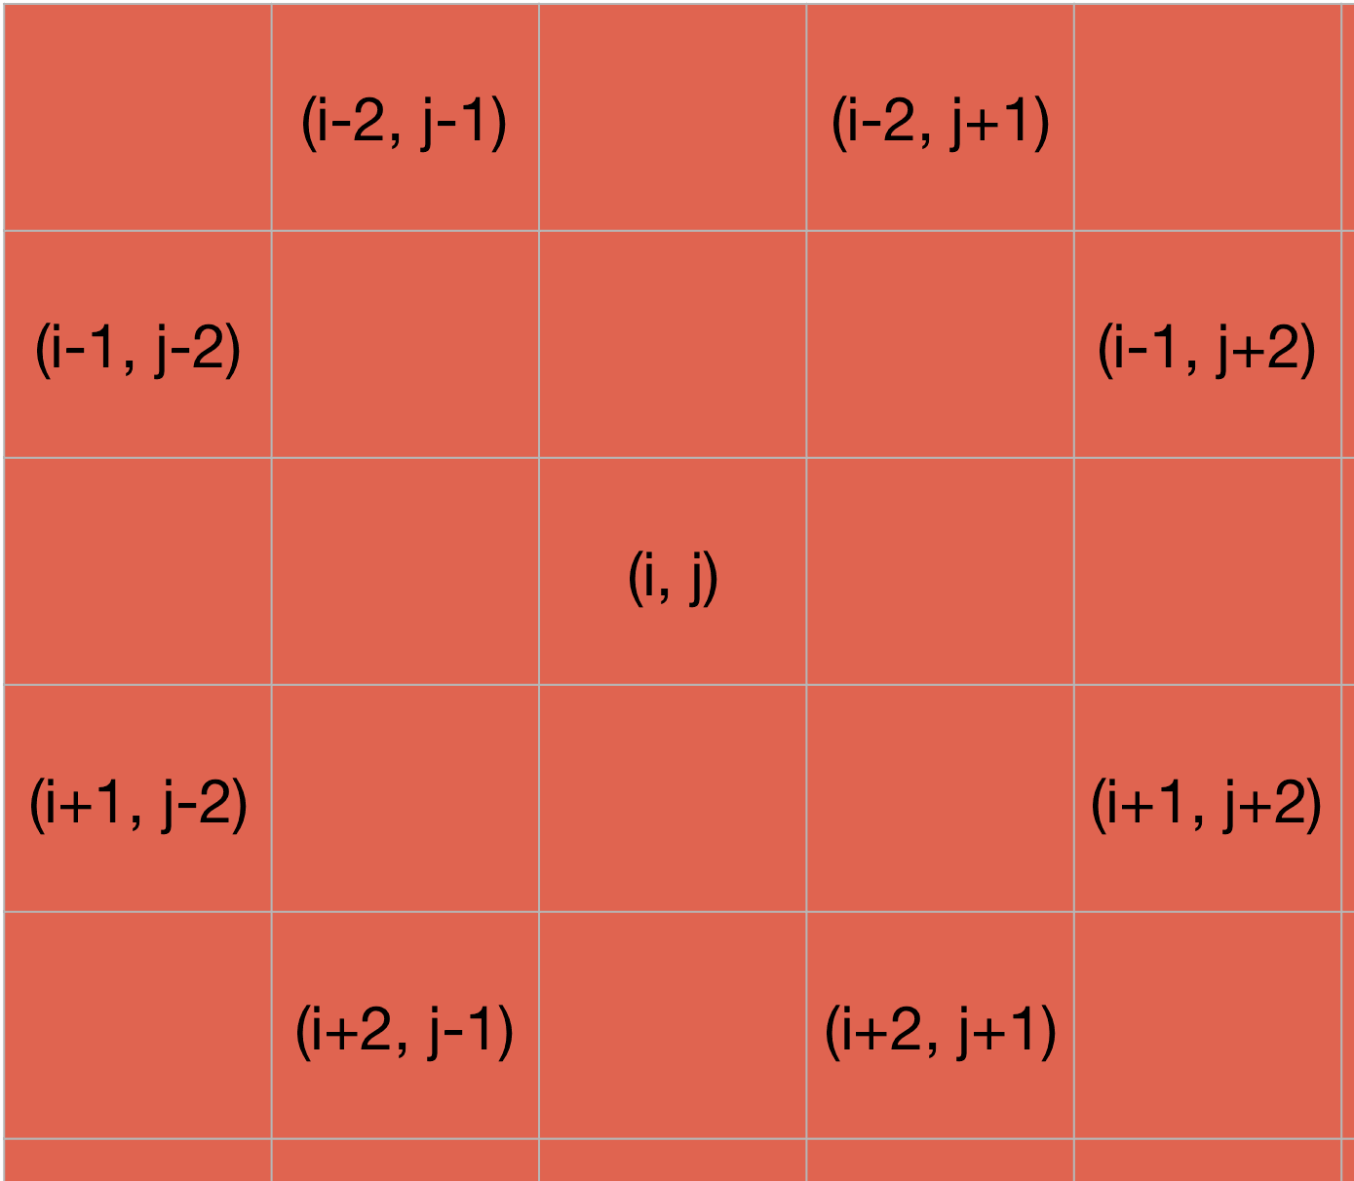
Approach to Knight’s Tour Problem using Backtracking (Brute force)
Algorithm Steps :
Travel the matrix to only valid cells marked in the row, column array as coordinates.
If the step is valid then mark the current move in that cell of the matrix.
If the current cell is not valid or like it does not help in a complete traversal of the matrix then recur back and change the current value of the matrix which was updated before the recursive step.
Recur until move equals the value of N*N where N represents the size of the chess board.

Slide 6
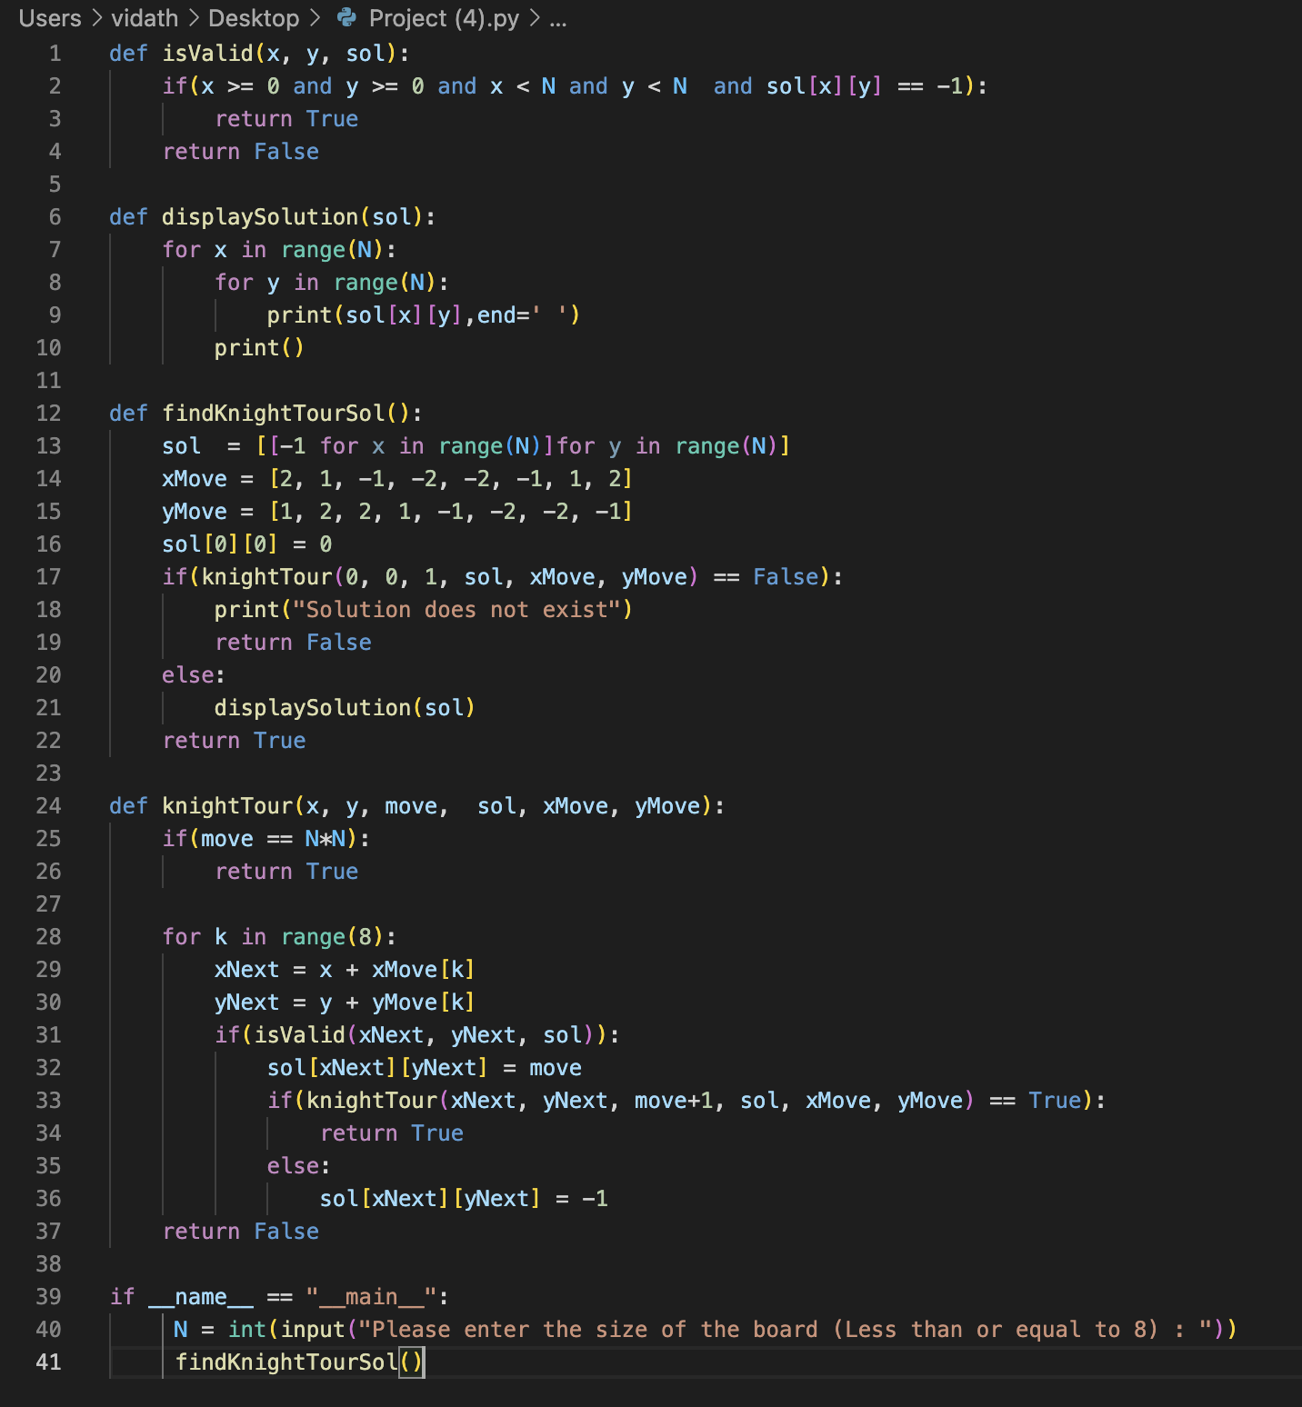
Code Implementation

Slide 7
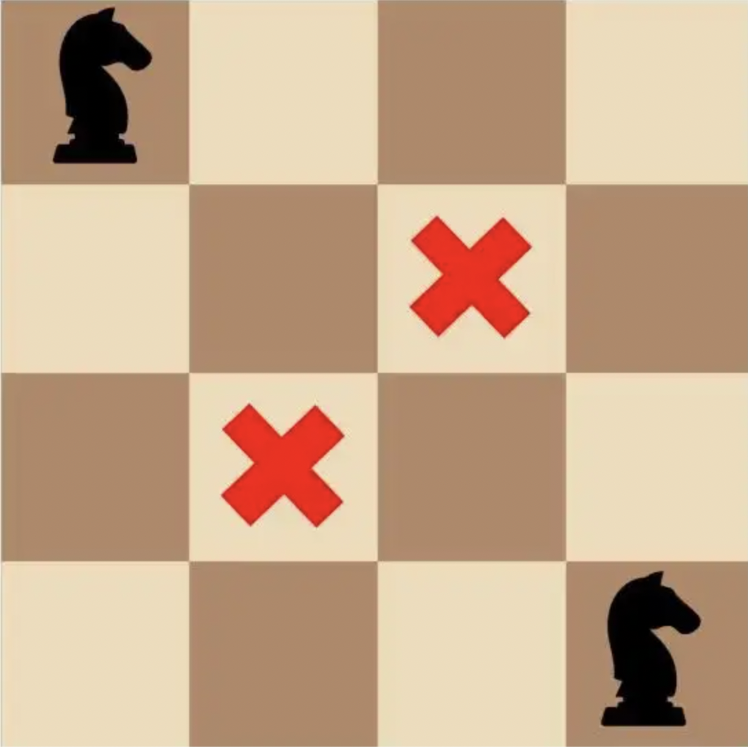
Output - 1
4×4 Matrix
The solution for the 4×4 doesn’t exist .
Since there are two pairs of these, the path must start at a corner square and end at an adjacent corner square.
This movement needs the help of one of the two remaining middle squares. So, we are only left with one middle square to go to the other two corners, which forms a self-loop and the knight cannot reach anywhere other than these two cells.
Knight’s Tour does not exist for boards less than 4*4.

Slide 8
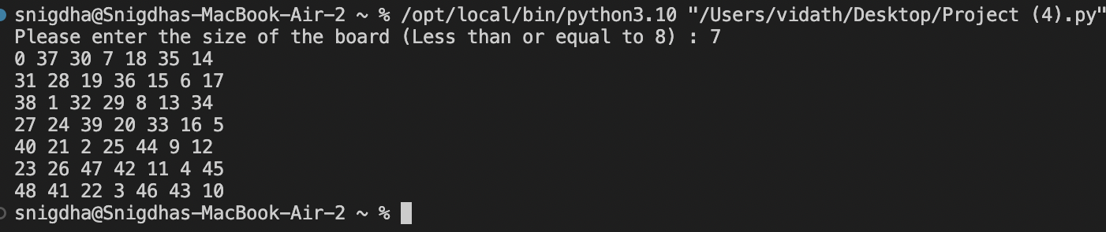
Output - 2
7×7 Matrix

Slide 9
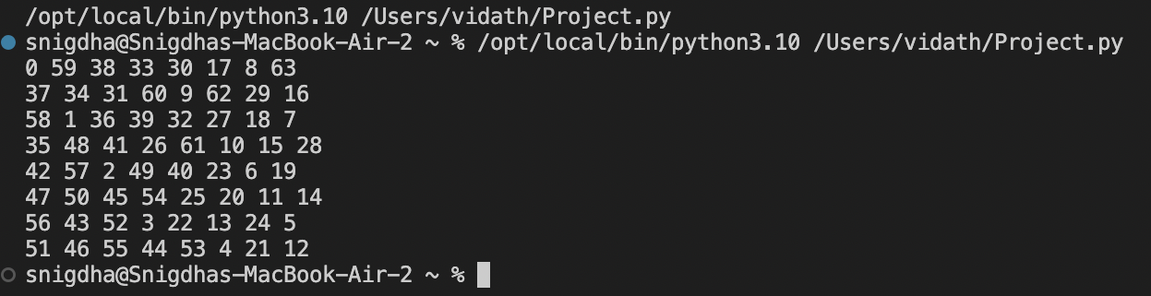
Output- 3
8×8 Matrix

Slide 10
Approach to Knight’s Tour Problem using
Depth First and Breadth First Search
Algorithm steps:
Initialize a class with board size and time limit as arguments. Initialize another class with parent, action as arguments.
Two lists namely queue and visited are used to keep track of the nodes to be visited and already visited nodes respectively.
Until the goal is not found, we pop the first element from the queue and increase the number of expanded nodes by 1 and we add this to the visited.
Now we will check whether the action taken is valid or not. If it is valid, we continue else we break out of the loop.
Finally, if we reach the goal state i.e, if all the squares have been visited by the knight, then we will print the solution else we will return solution not found.

Slide 11
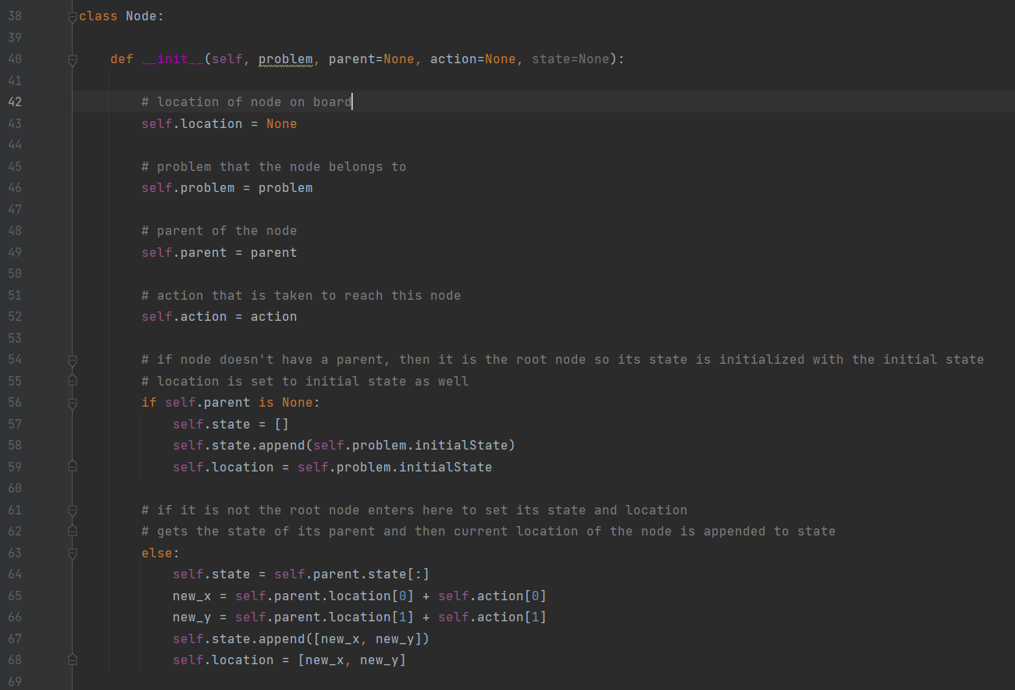
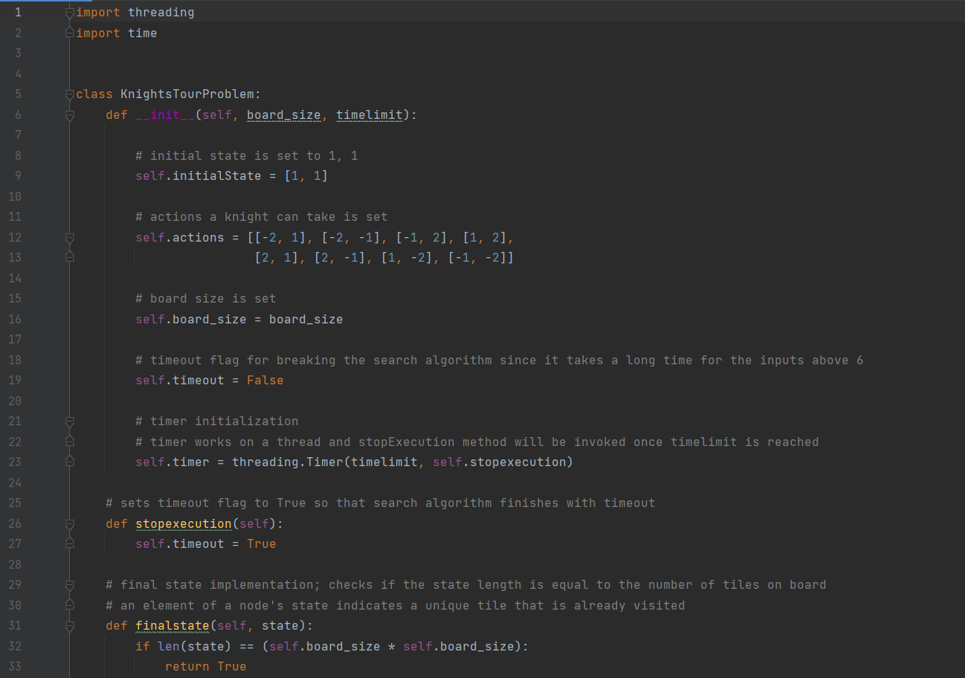
Code Implementation

Slide 12
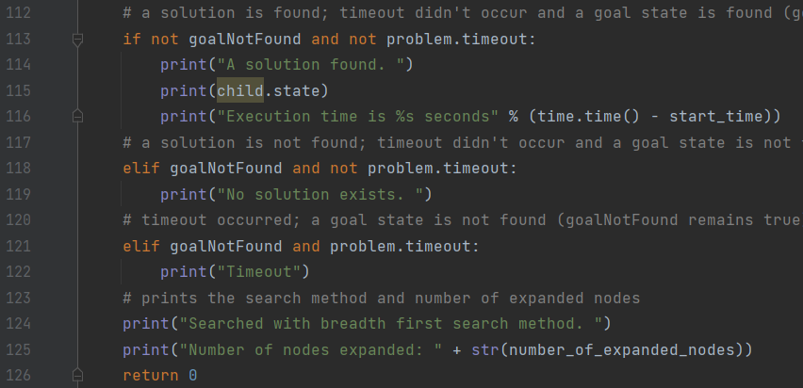
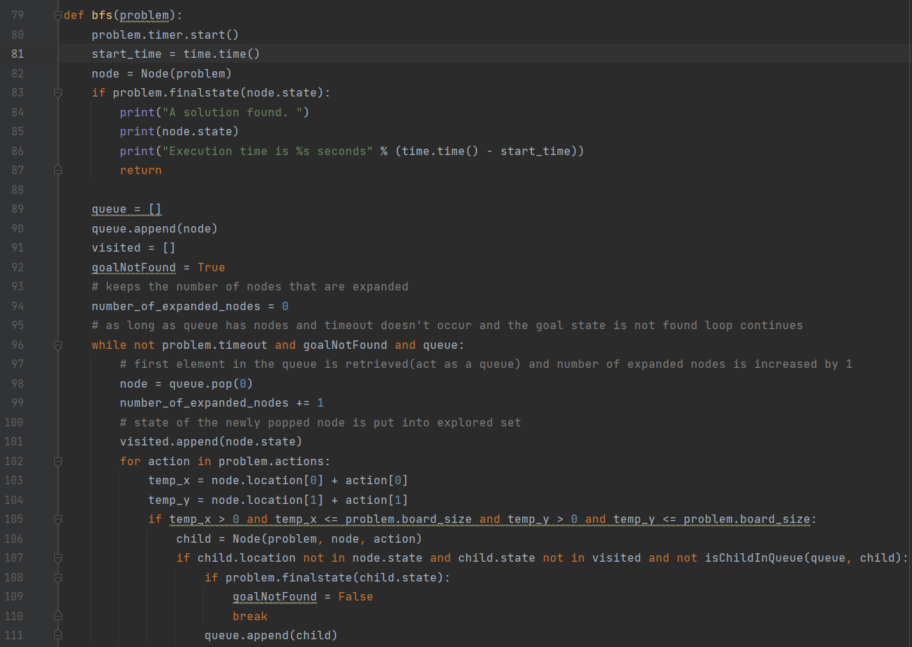
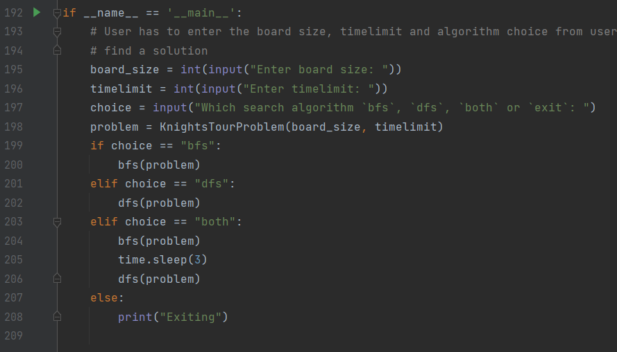
Code Implementation

Slide 13
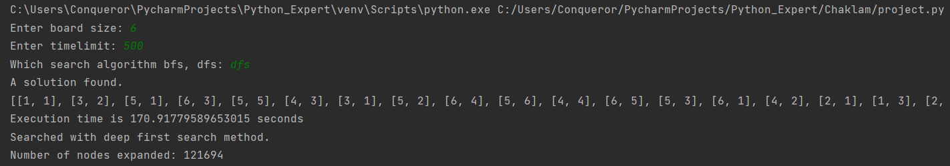
Output-1
Here the board size is 6 and time limit is set as 500 seconds. The algorithm used is DFS and the execution time is 170.9 seconds and expanded a total of 12 thousand nodes to find out the solution.

Slide 14
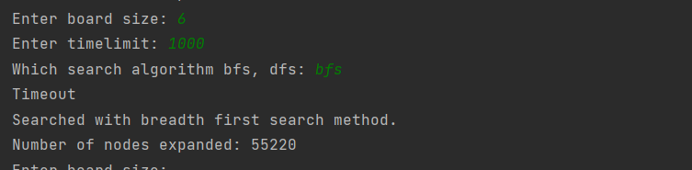
Output-2
Here the board size is 6 and time limit is set as 1000 seconds. The algorithm used is BFS. It expanded a total of 55 thousand nodes but no solution is found with in the given time limit.

Slide 15
Approach to Knight’s Tour Problem using Improved Depth First Search
We have improved the depth first search drastically by implementing the Warnsdorf’s rule. The heuristic works as follows:
The knight will choose his next move by moving to a square that has the fewest next possible moves. By sorting the nodes to visit by how many possible moves are next, our knight will always traverse the graph from the edges in.
This rule makes sense since it’s much easier to visit an empty square on the edge of a chessboard near the beginning of the tour without getting trapped than later on.

Slide 16
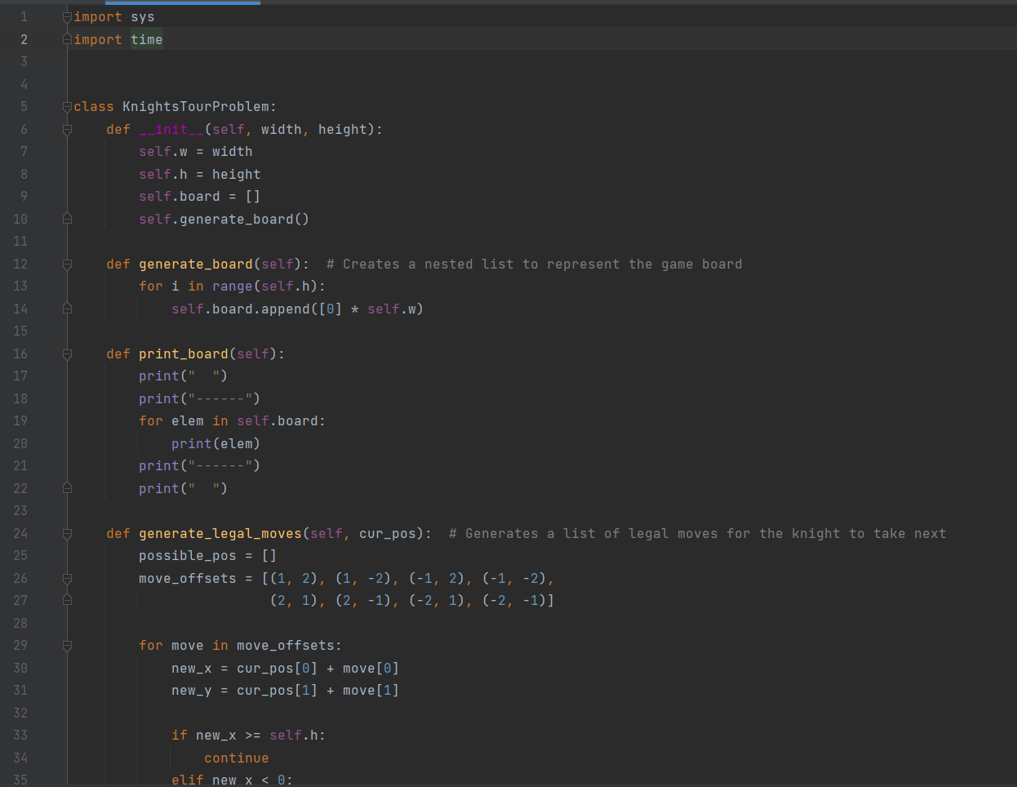
Code Implementation

Slide 17
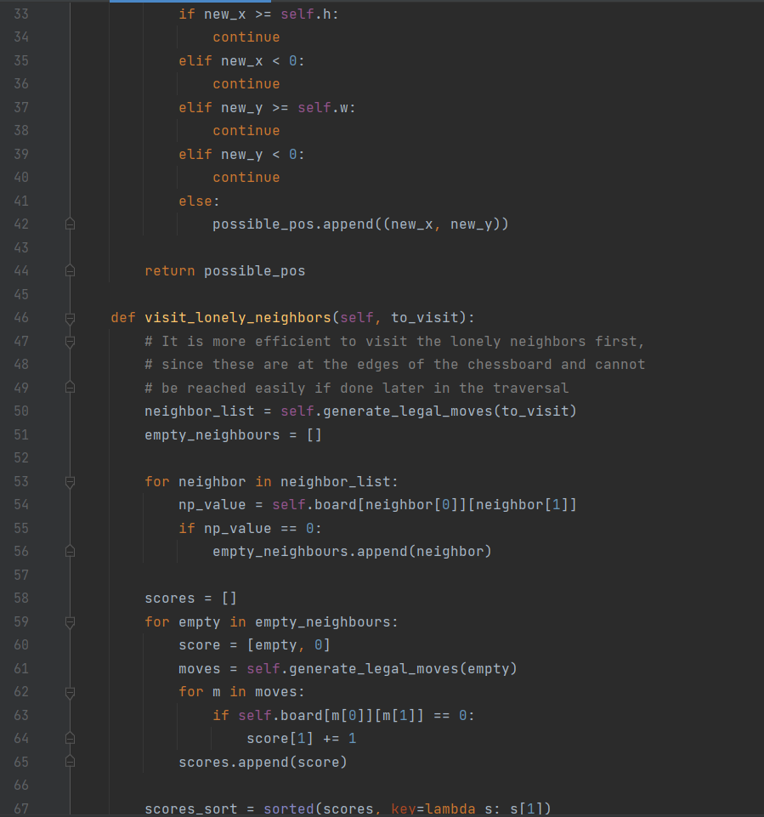
Code Implementation

Slide 18
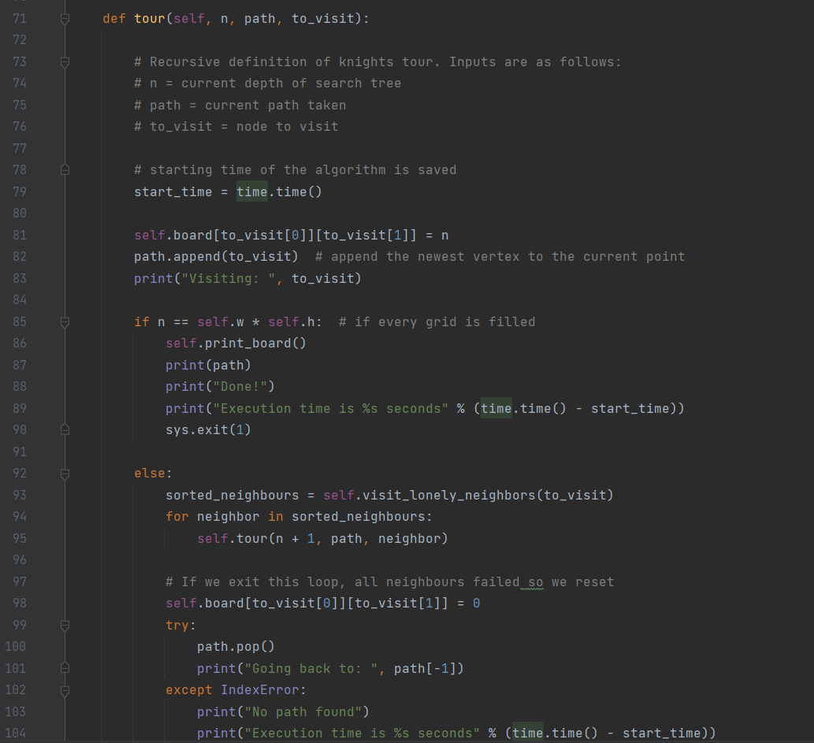
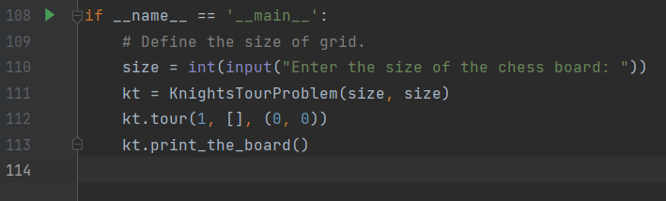
Code Implementation

Slide 19
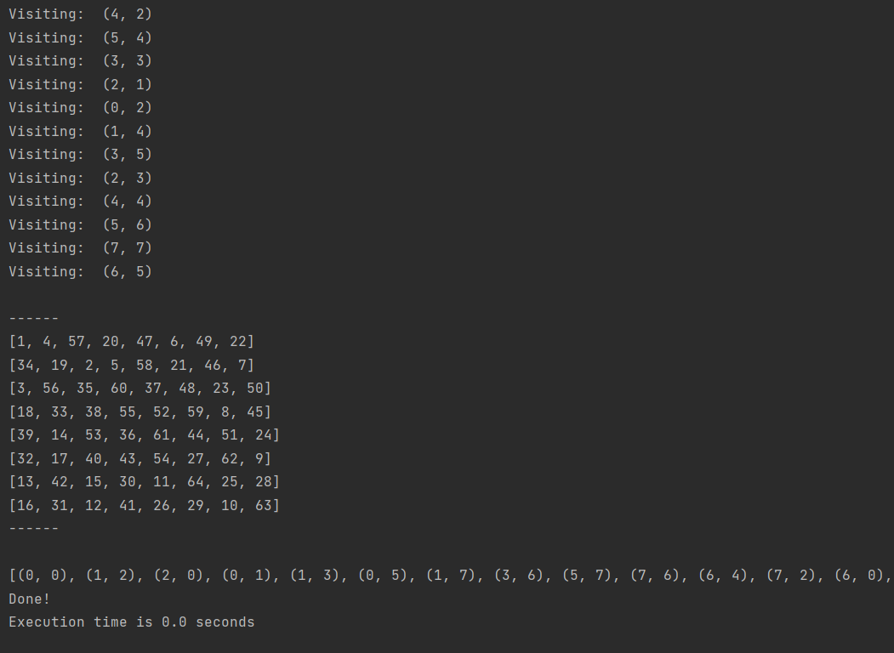
Output -1
Board size is 8

Slide 20
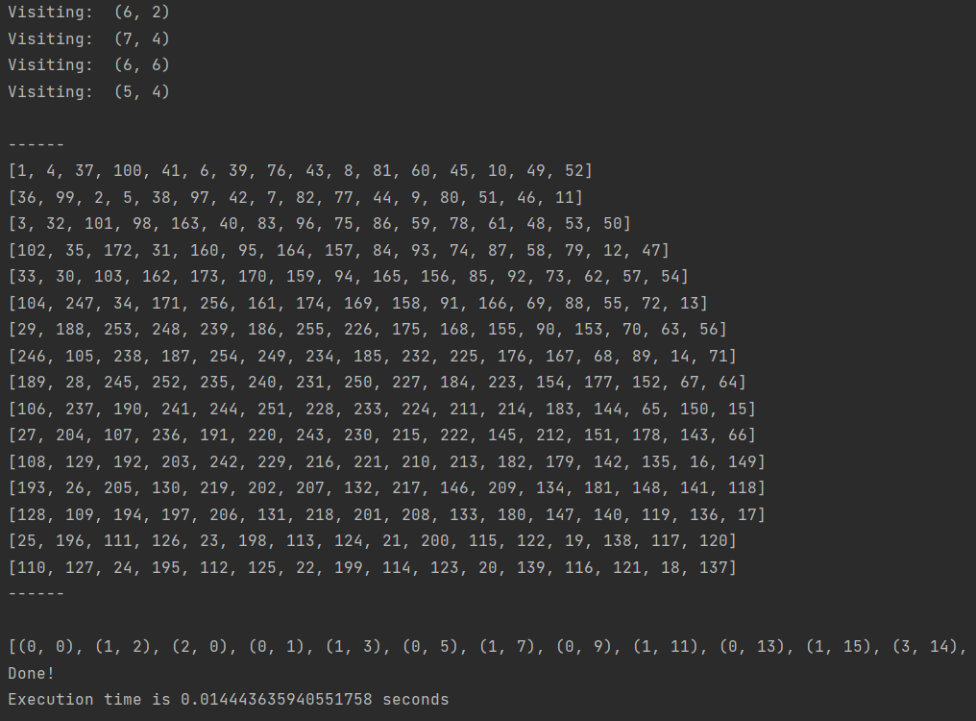
Output -2
Board size is 16

Slide 21
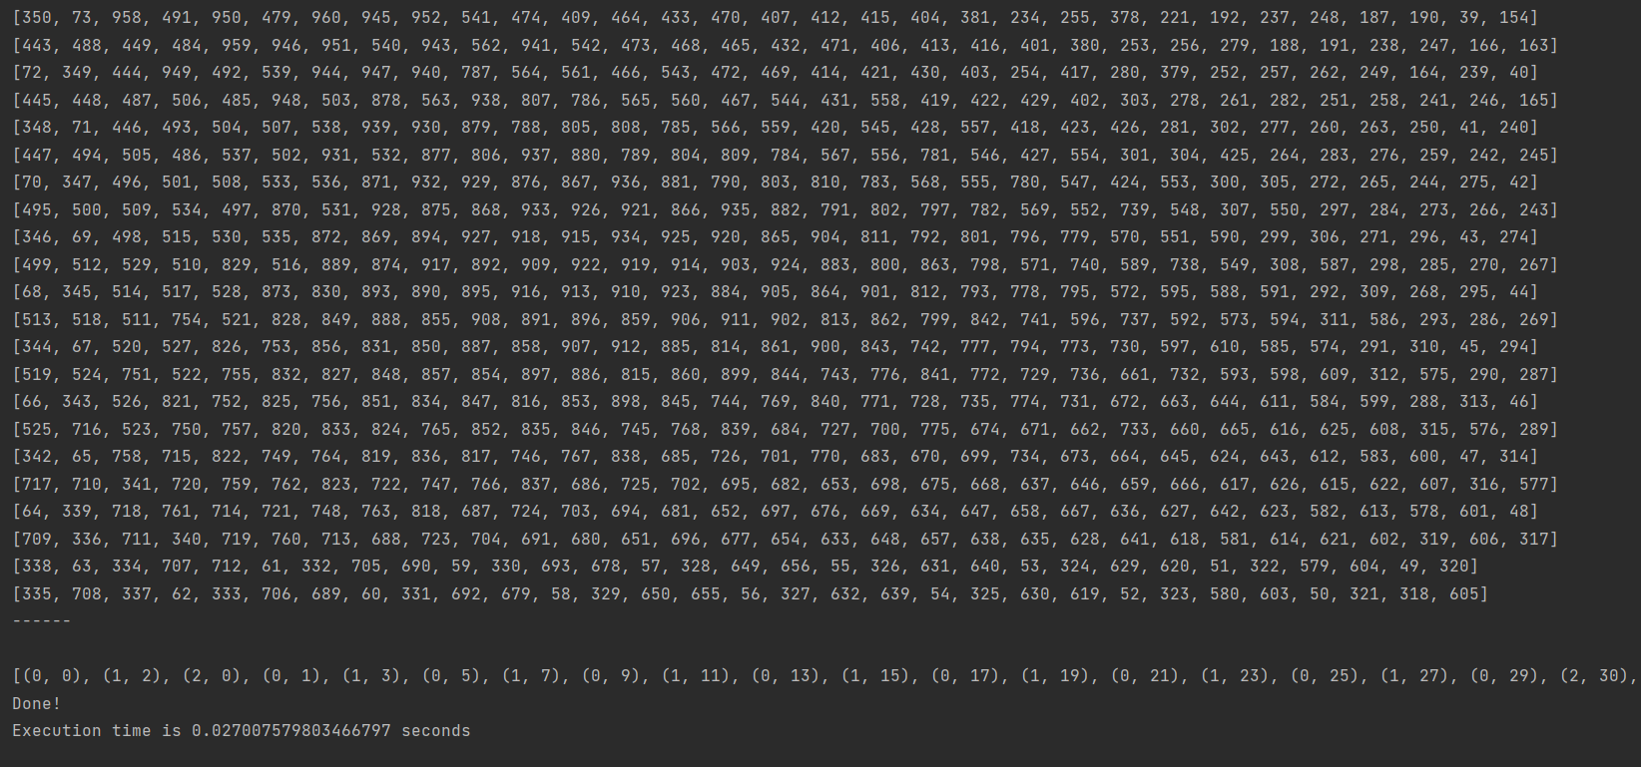
Output -2
Board size is 31

Slide 22
Comparison between Backtracking, DFS, BFS and improved DFS using Warnsdorff’s rule
Comparing among backtracking, DFS, BFS and Improved DFS, we can say that improved DFS which makes use of the Warnsdorff’s rule works faster i.e, it takes less than 1 second to visit the normal 8*8 chess board.
After that, backtracking takes time of 25 seconds to visit the normal 8*8 chess board.
DFS takes a lot of time to solve the normal 8*8 chess board but it takes almost around 170 seconds to visit the 6*6 chess board
BFS takes even more time to compute the 6*6 chess board so it is not feasible to solve the 8*8 chess board.

Slide 23
Part that we are proud of
The improved DFS which makes use of the Warnsdorff’s rule implementation is the part that we are most proud of.
Comparing it to the Backtracking and DFS implementations, it took less than 1 second to solve the normal chess board whereas backtracking took 25 seconds.
Not only that, it can solve up until 31*31 chess board in less than 1 second which we are very proud of.

Slide 24
Limitations of the implemented algorithms
Improved DFS solves a 31*31 chess board in less than 1 second but after that we are not able to solve anymore since we are facing a recursion depth exceeded error. Using Improved DFS we cannot solve chess boards greater than 31*31.
Backtracking solves efficiently upto 8*8 normal chess board but after that, it doesn’t solve anymore since the knight is struck and have no other squares to move from that point.
Similarly DFS can solve efficiently upto 5*5 chess board in less than a second. In order to solve 6*6 chess board, it took 170 seconds but after that the knight is struck.
BFS on the other hand took a lot of time to solve the 5*5 chess board which makes it the least feasible algorithm to solve the knight’s tour problem.

Slide 25
Future work
We want to take a deeper dive into the neural network implementations of the Knight’s Tour problem.
Improved DFS can be further enhanced to encounter the recursion depth exceeded error when solving chess boards greater than 31*31

Slide 26
Project Demo

